Slide 1
ML Take-Home Assignment: Demand Sensing Problem
By: Nafiseh (Shima) Ghasemi

Slide 2
Problem statement
A store planning team has asked for a reliable daily 1-month-out demand forecast to better prepare their workforce.
They are asking you to forecast the daily number of items sold (‘sales’ field) over all stores and products.
You are in September 2019 and you need to forecast the sales for the whole month of October 2019.

Slide 3
methodology
Explore and analyse the sales data.
Train a basic and simple ML model that forecasts the sales for the requested month.
Validate your model properly with historical data.
Design and implement an efficient API that uses the trained model and returns the
forecast for a given day. Example: api/predict?date=22102019 should return the forecasted sales for 22/10/2019

Slide 4
Model development & evaluation
The model and the notebook please find below:
30% of dataset was used for validation during training, also, validation loss was used for early stopping callback to prevent overfitting.

Slide 5

Model development & evaluation
Main findings
Since sales are a time series, and months and years are periodic, we should expect a relation between sales during same days of month and same times of year, so in addition to sales numbers, a periodic sine wave with a full period during month and year was added to discover this relation

Slide 6
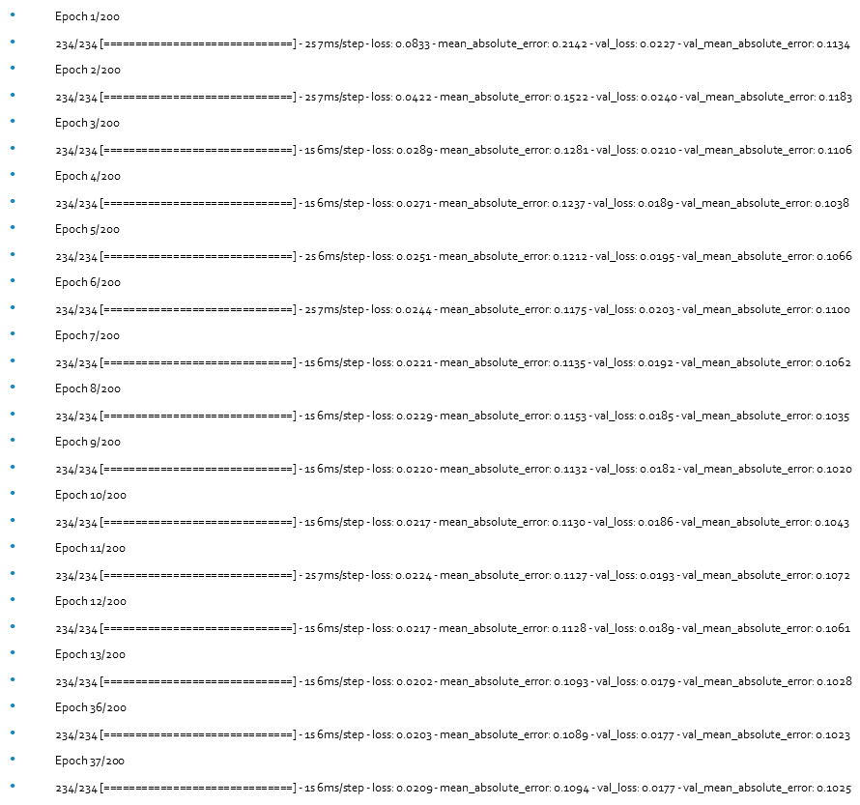
Model development & evaluation
A comparison between your model’s performance and a “baseline” model, using a few appropriate performance metrics
The chosen metric for loss function was Mean Squared Error, here is the error and loss log during training:

Slide 7
one-page schematic/architectural view of your API and analysis

Slide 8

How to use video

